Slide 1

BRING UP NEBRASKA
Mistaking Poverty as Neglect
Notes:
First Lady Susanne Shore

Slide 2
Reasons for child welfare involvement fall into what we call "neglect" rather than physical abuse or exploitation – 60%
Neglect can take the form of:
-- failing to attend school
--not keeping up with necessary medical care
--not meeting the emotional needs of a child.
--struggles to meet the basic, concrete needs of a family ----Substance use and or mental health challenges can exacerbate or perpetuate these challenges
Notes:
the faces of the children, youth, and parents involved in child welfare are black and brown or very poor and white—people who data tell us are more often economically vulnerable or disadvantaged.

Slide 3
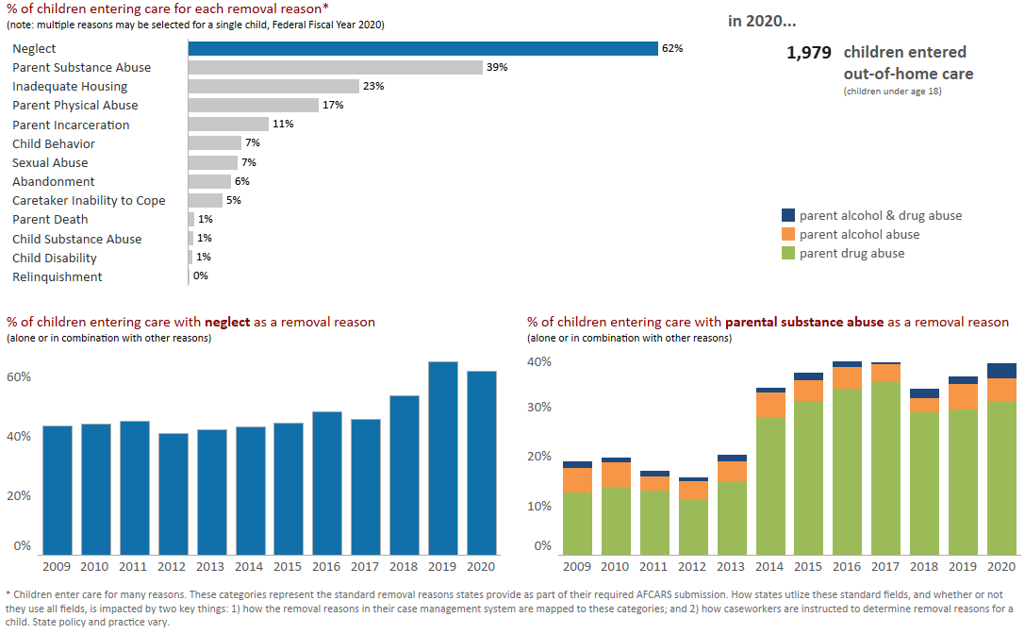
Why do children enter out of home care | Nebraska

Slide 4
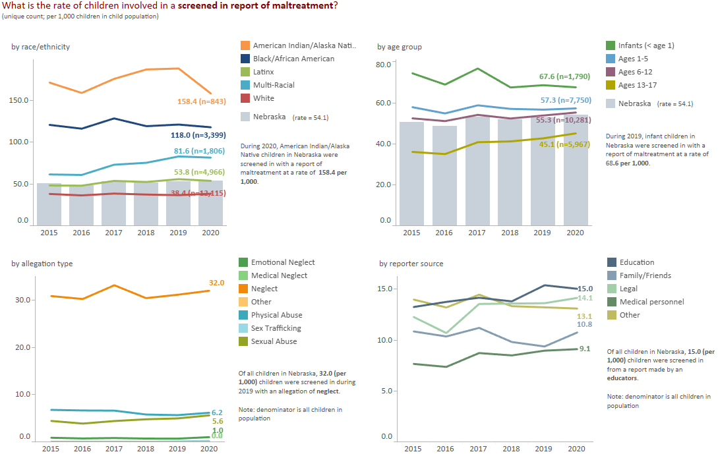
Screened In Investigations| Nebraska

Slide 5
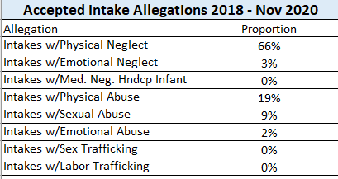
Abuse and Neglect
Highlight the 66% . Bill is there anything changes?
Notes:
Emily National number is 36%
30% Neglect
7% Physical abuse
2% sexual abuse
2% abondment

Slide 6
Parent Issues
(As removal Reason)
National parent substance abuse is 13% of reasons for removals Neb. Is 17%
Inadequate Housing is at 3%
Parent in Jail national is 2%, Nebraska is double at 4%
Notes:
Emily These are removals
National number is 19%
National parent substance abuse is 13% Neb. Is 17%
Housing is at 3%
Parent in Jail national is 2%, Nebraska is double at 4%

Slide 7
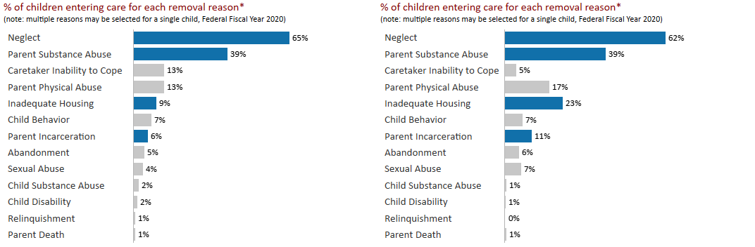
Abuse or Neglect (accepted) Allegations
In Nebraska, inadequate housing is the allegation in 23% of the cases versus 9% across the nation
Notes:
Emily NOTE: These are allegations (not removals)
National is 38%
However, housing is only 8% Nebraska is almost double that at 15%
Parent in jail is 5% national Nebraska is 7%

Slide 8
July1,2019 – June 30, 2020
Priority Area | Total Number of Requests for Support Services Funds | All Dollars | Percent of Total | Average Dollars per Request
Housing | 748 | $410,087 | 58.39% | $548
Utilities | 479 | $123,581 | 17.60% | $258
Mental Health | 290 | $52,471 | 7.47% | $181
Transportation | 179 | $29,318 | 4.17% | $164
Physical/Dental Health | 24 | $7,556 | 1.08% | $315
Parenting | 174 | $35,563 | 5.06% | $204
Other | 108 | $30,775 | 4.38% | $285
Daily Living | 63 | $9,504 | 1.35% | $151
Education | 10 | $3,202 | 0.46% | $320
Employment | 4 | $276 | 0.04% | $69
Total | 2,079 | $702,333 |  | $338
Notes:
Emily

Slide 9
Reason for Removal, by Location (2020) – Rate/1000
Prime Site Collaboratives | Inadequate Housing | Neglect |  | Parental Substance Abuse | Physical Abuse | Sexual Abuse | Other
Community and Family Partnership | 0.1 | 4.3 | 3.5 |  | 1.7 | 1.0 | 4.5
Douglas County Community Response Collaborative | 8.4 | 17.6 | 9.3 |  | 3.6 | 2.8 | 9.5
Growing Community Connections | 0.0 | 6.9 | 1.6 |  | 0.7 | 1.4 | 2.5
Hall County Community Collaborative | 1.8 | 8.6 | 4.5 |  | 2.0 | 0.9 | 4.4
Winnebago Tribe | 9.6 | 38.6 | 54.3 |  | 21.4 | 3.1 | 34.0
Nebraska | 2.0 | 7.0 | 4.3 |  | 1.8 | 0.9 | 3.7

Slide 10
Reporter Source for Screened in Reports of Maltreatment (2020) – Rate/1000
Prime Site Collaboratives | Education | Family/Friends |  | Legal | Medical Personnel | Other
Community and Family Partnership | 6.2 | 3.8 | 5.3 |  | 2.8 | 7.4
Douglas County Community Response Collaborative | 21.1 | 13.8 | 20.6 |  | 14.9 | 17.6
Growing Community Connections | 24.3 | 15.9 | 19.8 |  | 12.8 | 21.8
Hall County Community Collaborative | 11.4 | 8.6 | 8.2 |  | 5.4 | 11.6
Winnebago Tribe | 21.4 | 11.5 | 6.9 |  | 22.9 | 24.1
Nebraska | 15.4 | 9.4 | 13.6 |  | 9.0 | 13.2

Slide 11
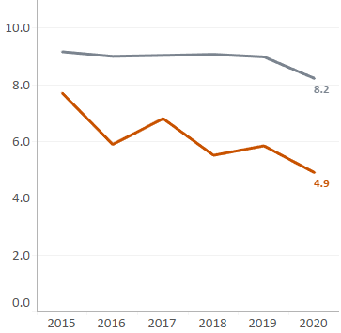
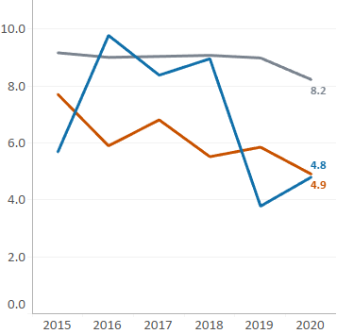
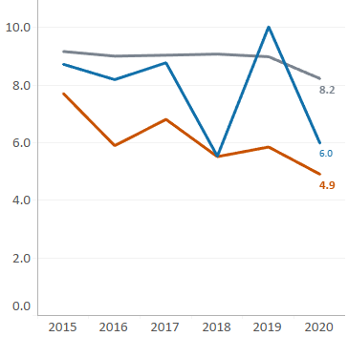

Screened In and Substantiated Investigations| Nebraska, Platte, and Douglass
State
Platte
Douglass

Slide 12
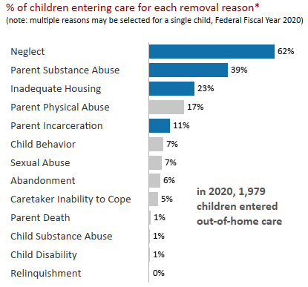
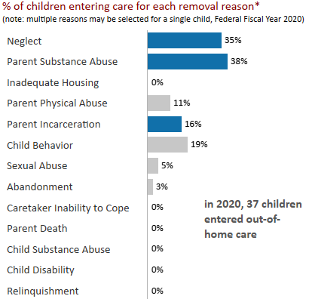
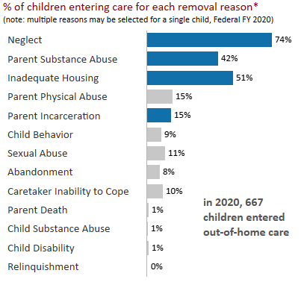
Why do children enter out-of-home care?| Nebraska, Platte, and Douglass
State
Platte
Douglass

Slide 13
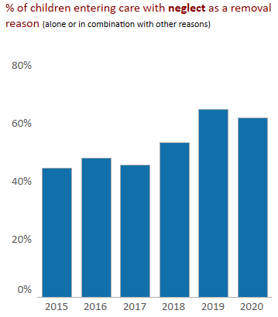
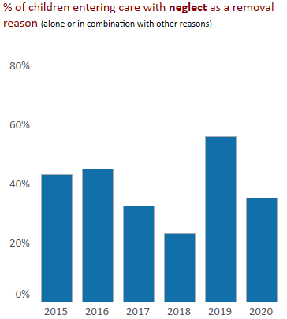
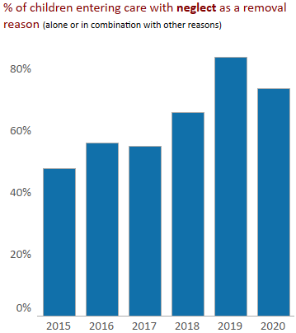
Why do children enter out-of-home care?| Nebraska, Platte, and Douglass
State
Platte
Douglass

Slide 14
Why do children enter out-of-home care?| Nebraska, Platte, and Douglass
State
Platte
Douglass

