Slide 2
Objectives
General overview of Central Navigation
Central Navigation function requirements for the state CYI system
Collective Impact processes for establishing and sustaining Central Navigation
Multi County capacity for central navigation and immediate response

Slide 3
System development and enhancement
Program grants
Traditional grant model
Funding in programmatic silos
Community grants
How NC has previously granted for Child Well Being work
Statewide system work
CYI grant to develop local and statewide system
Braided funding
Slight more prescriptive due to the need to develop common practices statewide

Slide 4
Central Navigation: Common language for accurate data
High touch/Low touch v Brief Contact/Active/Inactive/ Service end
For data collection purposes only
Youth will not hear these terms
Still in discussion at the statewide system level
Case Manager v Coach v Advocate
Also still in discussion at statewide level
Take the question to youth to get their input

Slide 5
Central Navigation
Description Statements
The Central Access Navigator (CN) coordinates transitional age youth services in (counties) served by partner agencies.
The CN serves as a central access point with unconnected youth ages 14 to 24 that are disconnected from a positive life course due to child welfare, homelessness or near homelessness, and/or juvenile justice system involvement, and are lacking services and supports they need to successfully transition to adulthood.
The CN assists youth in accessing requested services by collaborating with and making referrals to partner agencies to support youth in meeting their goals.
The CN responds to all referrals/requests in a timely manner, especially in emergency and housing.

Slide 6
Central Navigation
Description Statements
The CN assures that youth set their own goals and share in decisions about which services and supports are accessed.
The CN works collaboratively on behalf of (entity) with other community-based services to enhance the connected youth system by assisting in assessing service system needs, gaps, barriers, and assists in identifying strategies to address these issues for Transitional Age Youth.
The CN works to foster effective professional contacts with service providers, community representatives, consumer groups, representatives of judicial, educational and social services, young adults, youth, and their families in such a way as to create a climate conducive to person-centered, family driven care for youth and young adults.
Results Statement: Connect youth/young adults to supports and services within their community.

Slide 7
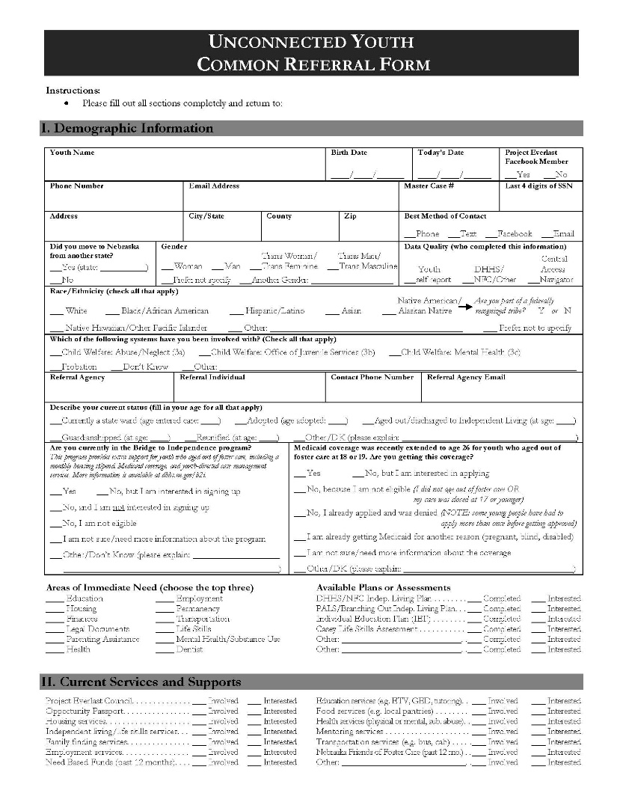
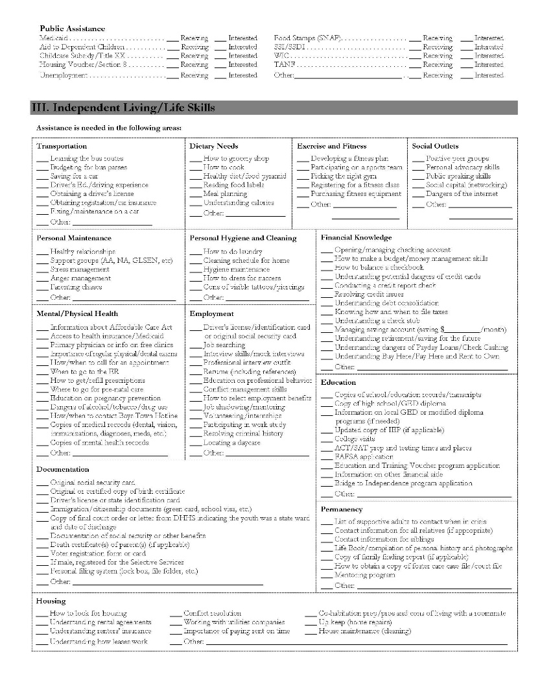
Common Referral Form

Slide 8
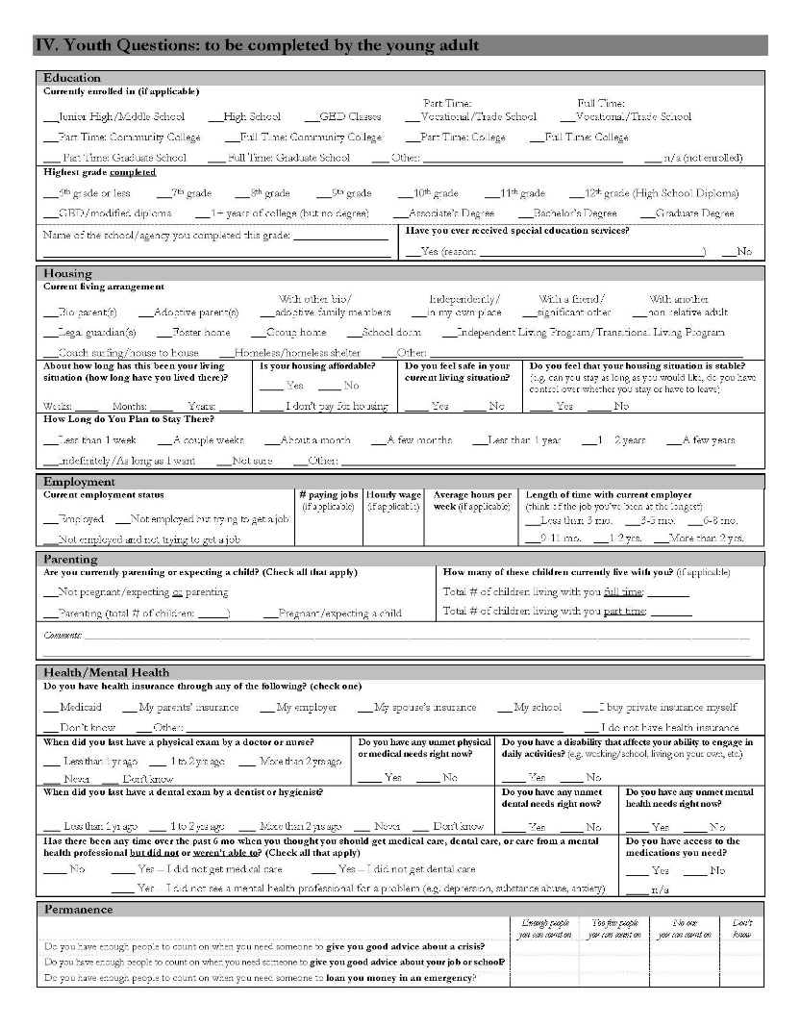
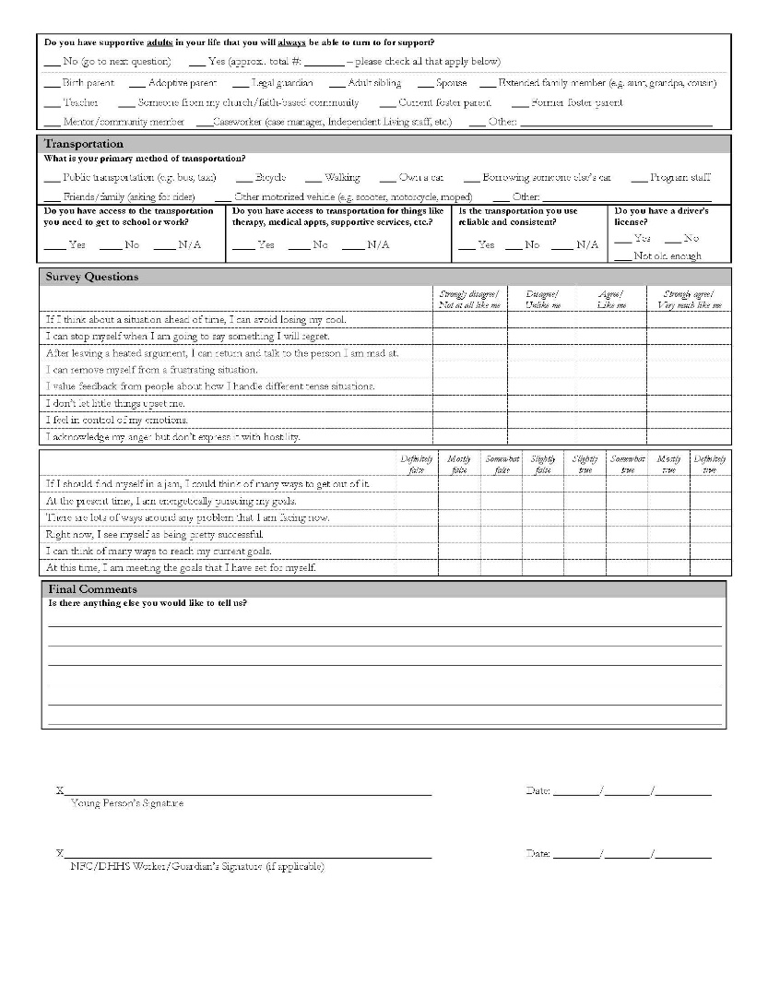
Common Referral Form (continued)

Slide 9
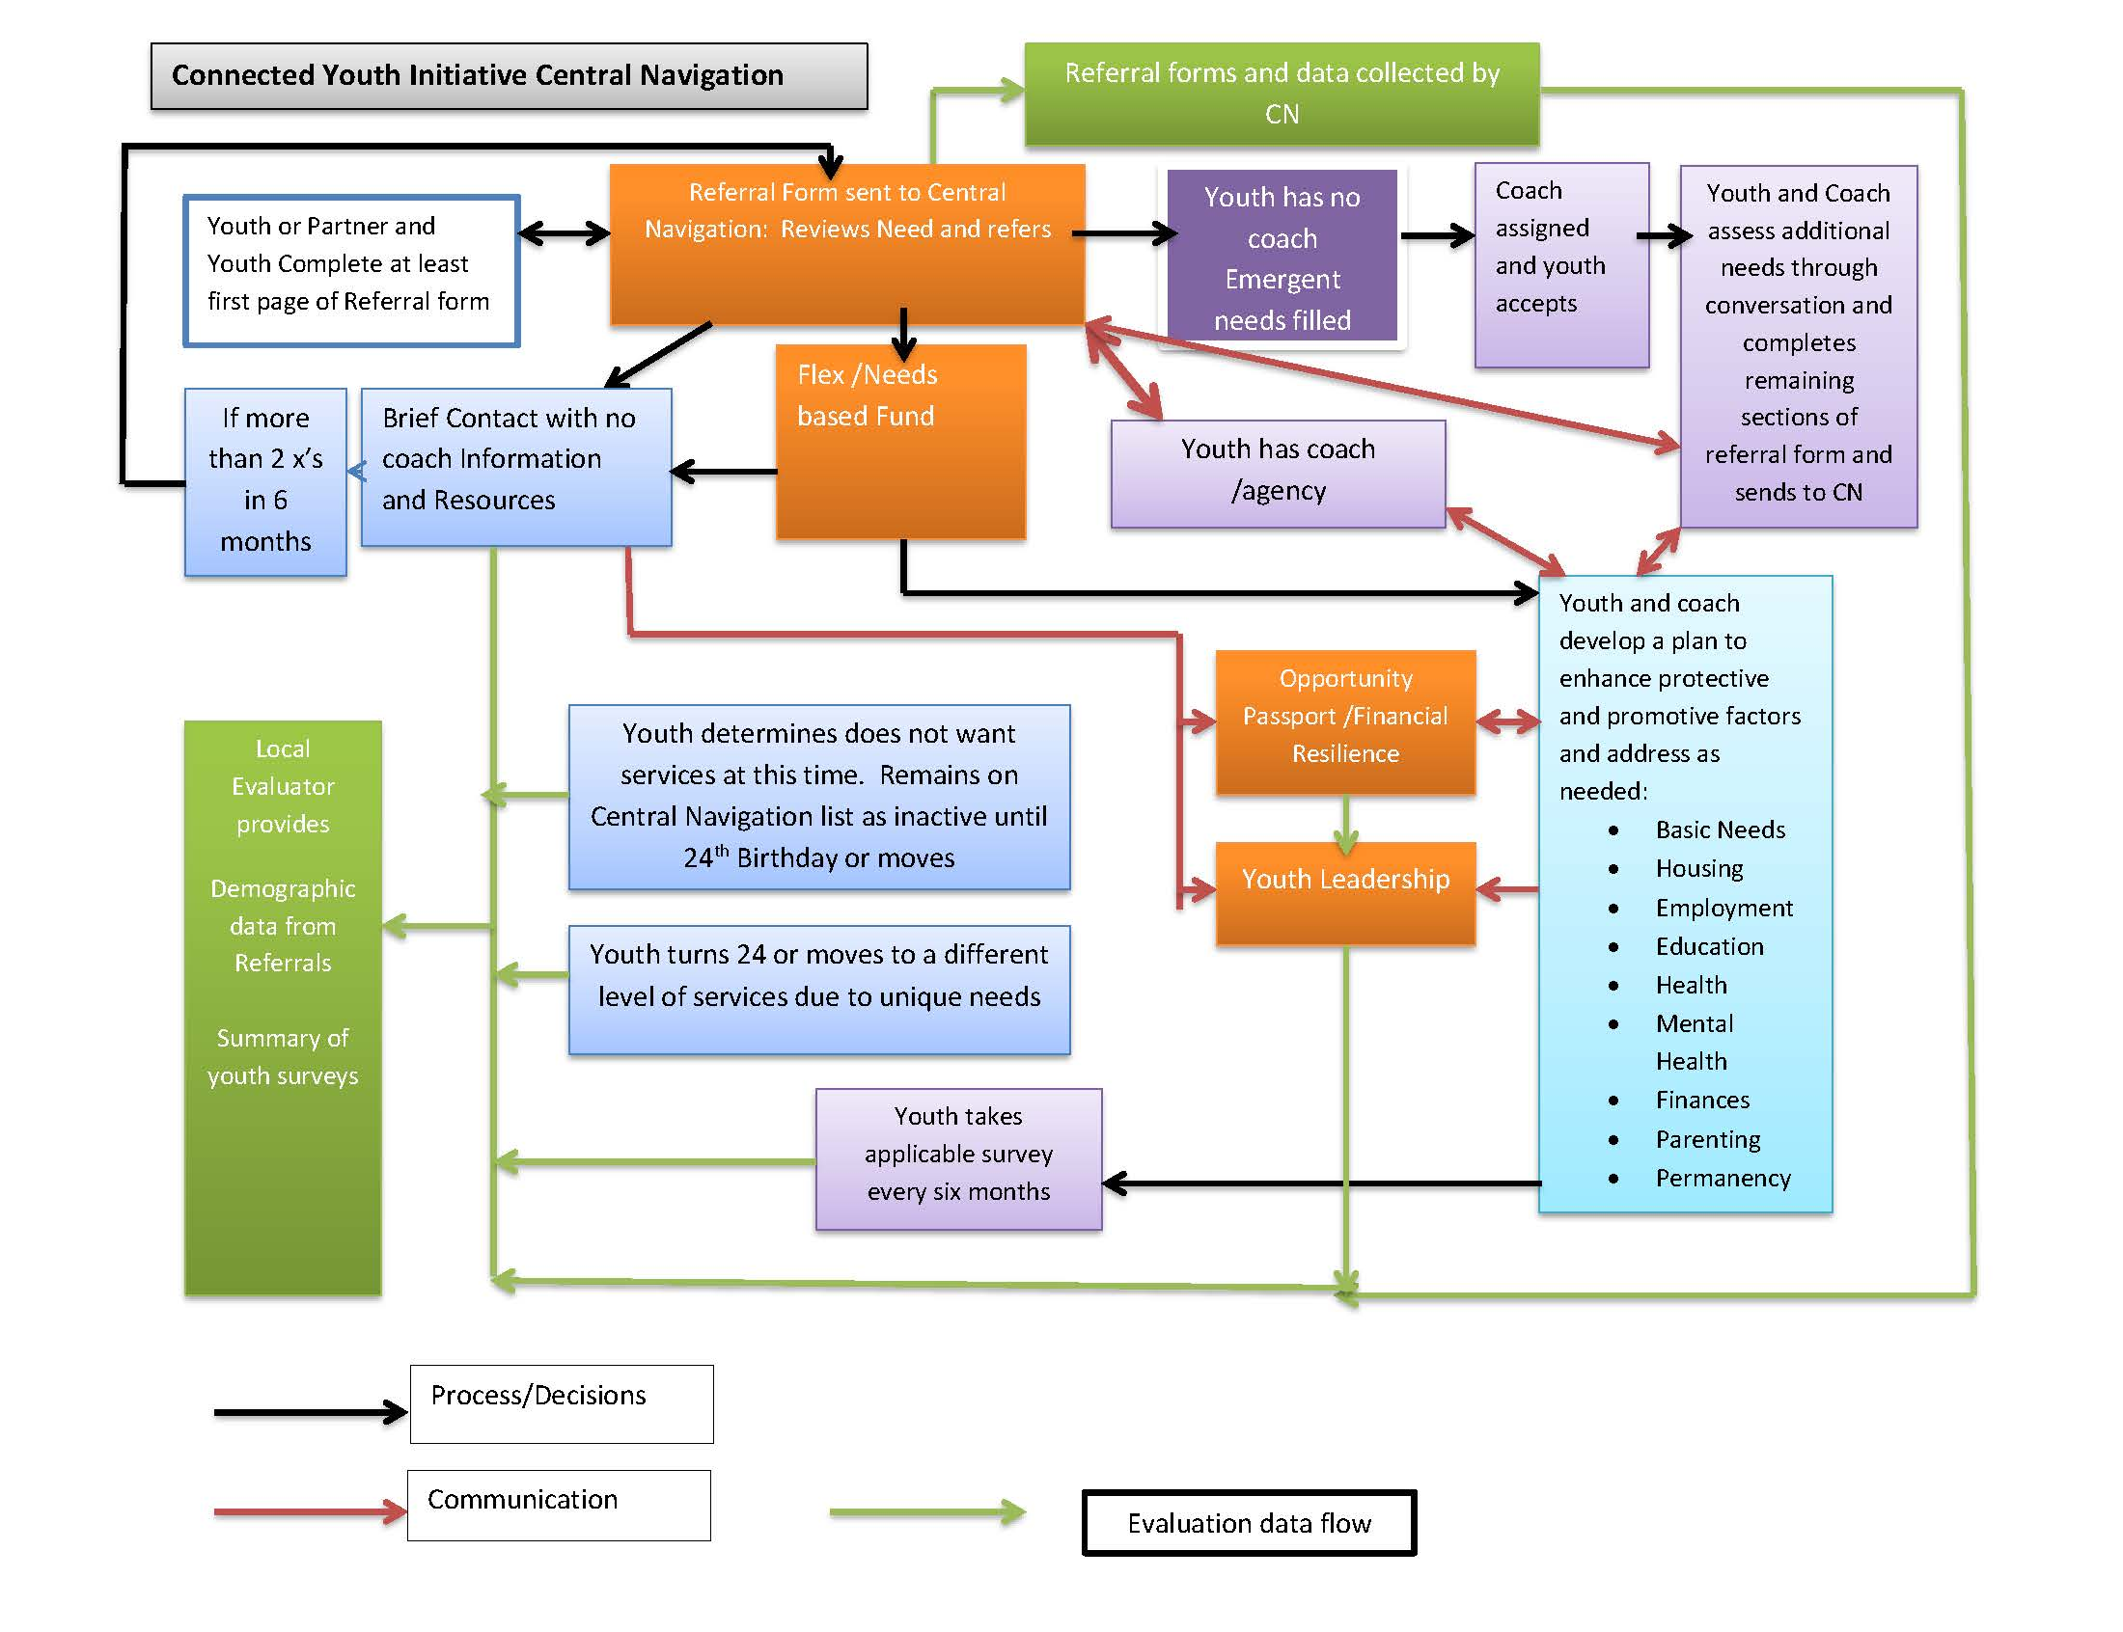
Central Navigation Flow Chart

Slide 10
Function: Referrals/Forms
CYI Requirements
Receive referrals from multiple community partners Assist youth in completing forms if they are not connected to agency Assure forms are completed properly Screen referral for eligibility If not eligible assist applicant in finding other resources.

Slide 11
Function: Allocate Services
CYI Requirements
Respond to multiple levels of resource needs Respond to and resolve all emergent requests in a timely manner If youth does not have a coach, allocate coaching assignments based on youth preference and regional decision tree Process requests for Needs Based Funds Process requests for Flex Funds If a Brief Contact requests funds twice in six months refer to a coach before processing request. Where required organize multi agency teams to meet needs of the youth

Slide 12
Function: Financial Response System
CYI Requirements
A system to respond with vouchers and checks within 12 hours.

Slide 13
Function: Data Collection
CYI Requirements
Forward all completed referrals to the evaluator Maintain a current unduplicated count of all youth in the system – including those not receiving CYI resources Maintain a data collection process which tracks youth and resource needs (until full HMIS implementation) on an annual basis Work in partnership with the local evaluator twice per year to conduct the youth surveys (see protocol) Assure that all required forms are sent to the evaluator Track service utilization Track brief contact, active or inactive

Slide 14
Function: Manage Resource Capacity
CYI Requirements
Access an up to date accounting of Needs Based Funds and Flex Funds to before approving additional resources Manage the local “coaching” resources – assuring that agencies that are funded to serve certain populations do so. And to assist in identifying the need for additional coaches Establish and process and maintain an up to date list of services and resources in each county served

Slide 15
Function: Continuous Quality Improvement
CYI Requirements
Provide monthly service utilization data reports to the partners. Participate in the CQI process to assist in clarifying

Slide 16
Function: Surveys and Evaluation
CYI Requirements
Serve as a single point of contact for all data and CN information for the project Assure utilization of required surveys and forms through dissemination of information

Slide 17
Function: Inter-system / Region Referrals
CYI Requirements
Establish fidelity with common statewide practices for all Central Navigation requirements Have knowledge of other CN’s for CYI and CWB and make referrals as required

Slide 18
Qualities and Skills Central Navigators
Neutrality- especially in high end services
Youth friendly communications and resources
Trauma informed communication skills
Person centered skills
Ability to convene and chair youth centered team meetings
Strong knowledge of community resources
Competent in interactions with diverse cultures, people in poverty, and persons with varying physical and mental capabilities
Strong organizational and documentation skills
Written and verbal communication skills
Expertise in online case management systems ( specific to community)

Slide 19
Collective Impact Sustainable Central Navigation
Sustain efforts by embedding them in the system
Central Navigator doesn’t do all the work
All agencies/providers have referral forms
Combine work with other CN work
Child Well Being
Homelessness Continuum of Care
Doesn’t require hiring a new person
Contract with other agency
Braided Funding for CN functions
Juvenile Justice Community Based Aid Funds can pay for “system development and enhancement”

Slide 20
Collective Impact
Combine this work with other Central Navigation work (homelessness, Community Response)
Bidding/Contracting with partner agency to do the work
Think about how to sustain this work without necessarily hiring new staff

Slide 21
CYI and CWB Crosswalk

Slide 22
Function: Referrals/Forms
CYI Requirements | CWB Requirements
Receive referrals from multiple community partners Assist youth in completing forms if they are not connected to agency. Assure forms are completed properly Screen referral for eligibility If not eligible assist applicant in finding other resources. | Receive referrals from multiple community partners & parents Assure forms are completed properly including the Pre Protective Factor survey attached to the referral form. Screen referral for eligibility If not eligible assist applicant in finding other resources.

Slide 23
Function: Allocate Services
CYI Requirements | CWB Requirements
Respond to multiple levels of resource needs. Respond to and resolve all emergent requests in a timely manner If youth does not have a coach, allocate coaching assignments based on youth preference and regional decision tree Process requests for Needs Based Funds Process requests for Flex Funds If a Brief Contact requests funds twice in six months refer to a coach before processing request Where required organize multi agency teams to meet needs of the youth | Respond to multiple levels of resource needs. Respond to and resolve all emergent requests in a timely manner If family does not have a coach, allocate coaching assignments based on youth preference and regional decision tree Process requests for Flex Funds If a Brief Contact requests funds twice in six months refer to a coach before processing request Where required organize multi agency teams to meet goals of the family

Slide 24
Function: Financial Response System
CYI Requirements | CWB Requirements
A system to respond with vouchers and checks within 12 hours.

Slide 25
Function: Data Collection
CYI Requirements | CWB Requirements
Forward all completed referrals to the evaluator Maintain a current unduplicated count of all youth in the system – including those not receiving CYI resources Maintain a data collection process which tracks youth and resource needs (until full HMIS implementation) on an annual basis Work in partnership with the local evaluator twice per year to conduct the youth surveys (see protocol) Assure that all required forms are sent to the evaluator Track service utilization Track brief contact, active or inactive | Forward all completed referrals to the evaluator Maintain a data collection process which tracks families and resource needs (until full HMIS implementation) on an annual basis Work in partnership with the local evaluator to assure that all data is collected twice a year (CWB template) Assure that all required forms are sent to the evaluator Track service utilization Track brief contact or active Collect and report required RBA Data

Slide 26
Function: Manage Resource Capacity
CYI Requirements | CWB Requirements
Access an up to date accounting of Needs Based Funds and Flex Funds to before approving additional resources Manage the local “coaching” resources – assuring that agencies that are funded to serve certain populations do so. And to assist in identifying the need for additional coaches Establish and process and maintain an up to date list of services and resources in each county served | Access an up to date accounting Flex Funds to before approving additional resources Manage the local “coaching” resources – assuring that agencies that are funded to serve certain populations do so. And to assist in identifying the need for additional coaches Establish and process and maintain an up to date list of services and resources in each county served

Slide 27
Function: Continuous Quality Improvement
CYI Requirements | CWB Requirements
Provide monthly service utilization data reports to the partners. Participate in the CQI process to assist in clarifying | Provide monthly service utilization data reports to the partners. Participate in the CQI process to assist in clarifying

Slide 28
Function: Surveys and Evaluation
CYI Requirements | CWB Requirements
Serve as a single point of contact for all data and CN information for the project. Assure utilization of required surveys and forms through dissemination of information | Assure that the Post Protective Factor Survey is completed and forwarded to the evaluator Assure utilization of required surveys and forms through dissemination of information Assure that the Satisfaction Survey is completed and forwarded to the external evaluator

Slide 29
Function: Inter-system / Region Referrals
CYI Requirements | CWB Requirements
Establish fidelity with common statewide practices for all Central Navigation requirements Have knowledge of other CN’s for CYI and CWB and make referrals as required | Establish fidelity with common statewide practices for all Central Navigation requirements Have knowledge of other CN’s for CYI and CWB and make referrals as required

