Slide 1


Early Childhood Mental Health
ECMH Services in Nebraska
The University of Nebraska does not discriminate based on race, color, ethnicity, national origin, sex, pregnancy, sexual orientation, gender identity, religion, disability, age, genetic information, veteran status, marital status, and/or political affiliation in its programs, activities or employment.

Slide 2


The Nebraska Resource Project for Vulnerable Young Children
Our mission is to improve the well-being of maltreated young children in Nebraska.
Notes:
Our mission is to improve the well-being of maltreated young children in Nebraska.

Slide 3



ECMH Team
Projects
  Child-Parent Psychotherapy
  Parent-Child Interaction Therapy (IoWA-PCIT)
  Outreach and training to professionals
  Online training series (Trauma Screen, Classroom)
  Community of Practice to ECMH clinicians

Slide 4

Early Childhood
Mental Health
1. The most growth and development of the entire life cycle and the most sensitive period of brain development.
2. Experiences that a child has during this time shape the architecture of the brain.
3. Emotional, social, and cognitive competencies unfold in the context of the caregiving relationships.
4. There are misconceptions that young children are inherently resilient and are immune to the early effects of adversity and trauma.

Slide 5

What do these evidence-based practices have in common?
They are all focused on the parent child-relationship.
Why focus on the Attachment Relationship?
“Loving parental care has unmatched transformational powers in restoring the child’s developmental momentum in risk situations.”
This Photo by Unknown Author is licensed under CC BY-SA

Slide 6
ECMH Services in Nebraska Video

Slide 7

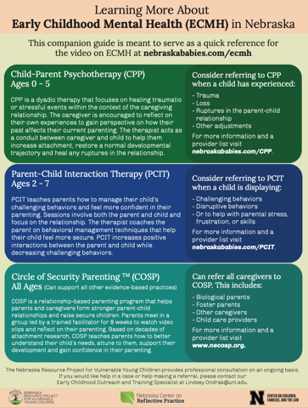
ECMH Services in Nebraska Video and Guide
www.nebraskababies.com/ecmh

Slide 8
3 Evidenced-Based Practices in Nebraska
Child-Parent Psychotherapy (CPP)
Parent-Child Interaction Therapy (PCIT)
Circle of Security Parenting (COS-P)

Slide 9
Child Parent Psychotherapy

Slide 10
A CPP Session:
Some examples of types of interventions:
  Symbolic play to create trauma narrative
  Touch to help restore physical contact
  Parental guidance in appropriate expectations for the child’s developmental stage
  Modeling protective behavior in play or when safety issues present themselves
  Providing emotional support for the parent while the child acts out the trauma narrative
  Concrete assistance for basic needs – referrals to agencies that can assist with basic needs
  Helping to link the past and the present for parents – their trauma linked to their parenting

Slide 11



Nebraska CPP Training Team
Barbara Jessing, LMFT, LIMHP
Mark Hald, PhD
Paula Ray, PsyD
NE CPP Trainer
bejessing@cox.net
NE CPP Trainer
mhald@optionspsych.biz
NE CPP Trainer
paularaypsyd@mac.com

Slide 12


Nebraska CPP Training Team
Training of Trainer
Joy Osofsky, PhD
Samantha Byrns, LIMHP, LPC, NCC
National CPP Trainer
CPP Trainer of Trainers
NE CPP Apprentice Trainer
sbyrns2@unl.edu

Slide 13
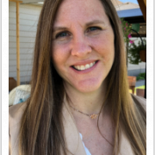

Nebraska CPP Training Team
Sarah Bernhardt, LIMHP
Lori Rodriquez-Fletcher, LICSW
NE CPP Apprentice Trainer
NE CPP Apprentice Trainer

Slide 14
When to refer a child and parent for CPP?
Complete a Trauma Screening to identify the need for services
Consider referring to CPP when a child has experienced:
- Trauma
- Loss
- Ruptures in the parent-child relationship
- Other adjustments (moving placements)
For more information and a provider list visit
nebraskababies.com/CPP

Slide 15


Slide 16
Parent-Child Interaction Therapy
(IoWA-PCIT model)

Slide 17
Structure of PCIT coaching sessions
Parent wears a bug-in-the-ear receiver while playing with child in playroom.
Therapist observes and coaches from an observation room using a microphone.
Therapist codes parent and child behaviors at start of session (5 min.).
Therapist coaches specific identified skills based on 5 min of coding.
*Spouses take turns being coached with child and observing spouse’s coaching.

Slide 18



Nebraska PCIT Training Team
Samantha Byrns
Joanna Halbur
Jea Theis

Slide 19
When do you refer a child & parent to PCIT?
Consider referring to PCIT when a child is displaying:
- Challenging behaviors
- Disruptive behaviors
- Concerns with attachment
- Or to help with parental stress, frustration, or skills
For more information and a provider list visit
nebraskababies.com/PCIT

Slide 21
Circle of Security - Parenting

Slide 22
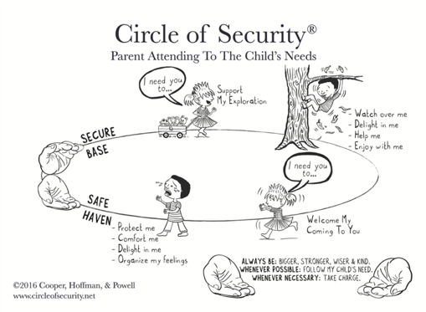

Circle of Security Parenting (COSP)
8-week relationship-based parenting program​
Build on decades of attachment research and is evidenced based model
Facilitators of the program are from different backgrounds

Slide 23
When do you refer parents to COSP?
- For support of the parent-child relationship
- Can refer all caregivers to COSP including:
Biological parents
Foster parents
Other caregivers
For more information and a provider list visit
www.necosp.org

Slide 24
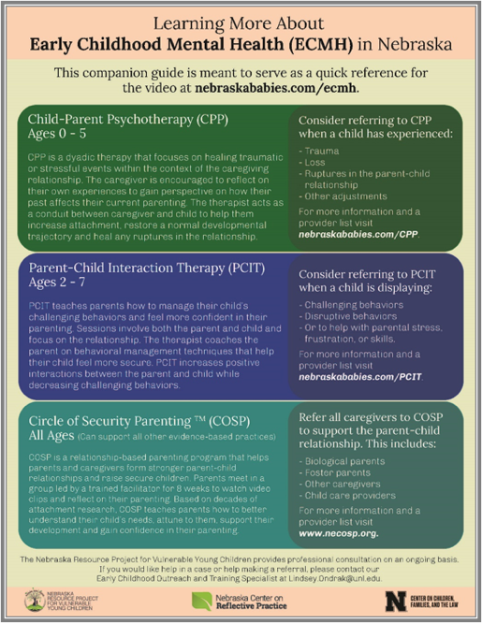

www.nebraskababies.com/ecmh

Slide 25

Thank you
Samantha Byrns, ECMH Project Manager
sbyrns2@unl.edu
Lindsey Ondrak, ECMH Outreach & Training Specialist
Lindsey.ondrak@unl.edu
This Photo by Unknown Author is licensed under CC BY

