Slide 1


Slide 2
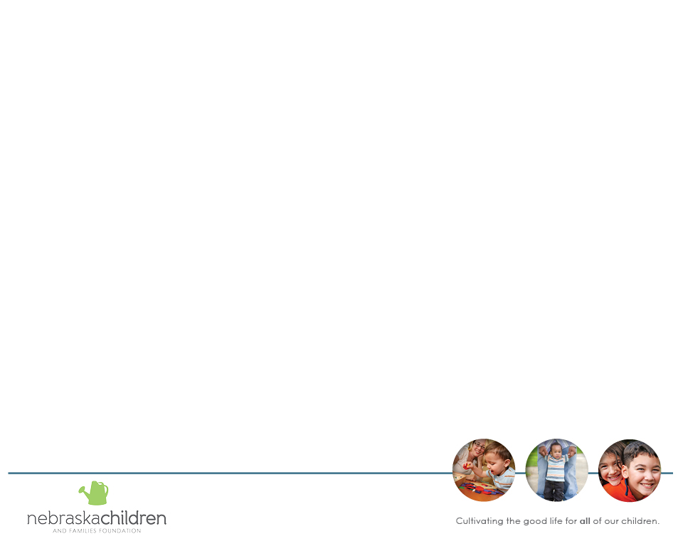
Community CARES Response and
Recovery Grant Opportunity
Purpose of today’s webinar:
To offer guidance in preparing community response
and recovery applications for funding needed to
address well-being challenges the COVID-19 pandemic has imposed on children, youth, and families.

Slide 3
Outline for today’s webinar
Response & Recovery Grant Opportunity Overview – Purpose, Source of Funds, and Deadlines
  Federal COVID –19 Relief Fund Matrix
  Eligible Applicants
  Eligible Use of Funds
  Application - How to Make the Case for Your Community's Needs:
    NE Community Opportunity Map
    Vulnerability Index
    COVID-19 Exposure Rates
    Playbook Needs
    Housing Response
  Budget and Accountabilities
  Goals
  How to Apply
    Online Application Process and Tips
    Requirements
  Support
  Questions

Slide 4
Purpose of Community CARES Response and Recovery Grant (R&R)
The purpose of the R&R Grant is to encourage entities to exceed its pre-pandemic operations and programming in response to increased needs of its service area.
Charitable organizations and providers can use the Community CARES Response & Recovery Grant as working capital to pay for operational expenses above its usual costs in order to meet the health and human service needs due to the pandemic, with the purpose of helping sustain operations to continue providing housing security, food access and behavioral health resources, and other COVID-19- related response and recovery activities in its usual service area.

Slide 5

Nebraska COVID-19 Funding Matrix

Slide 6
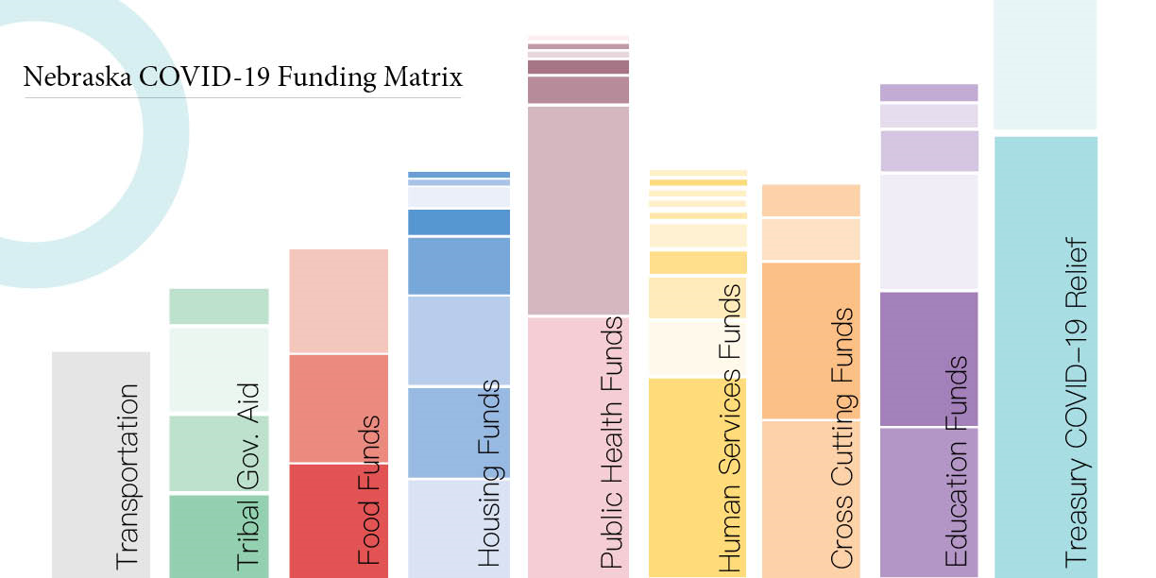

Slide 7
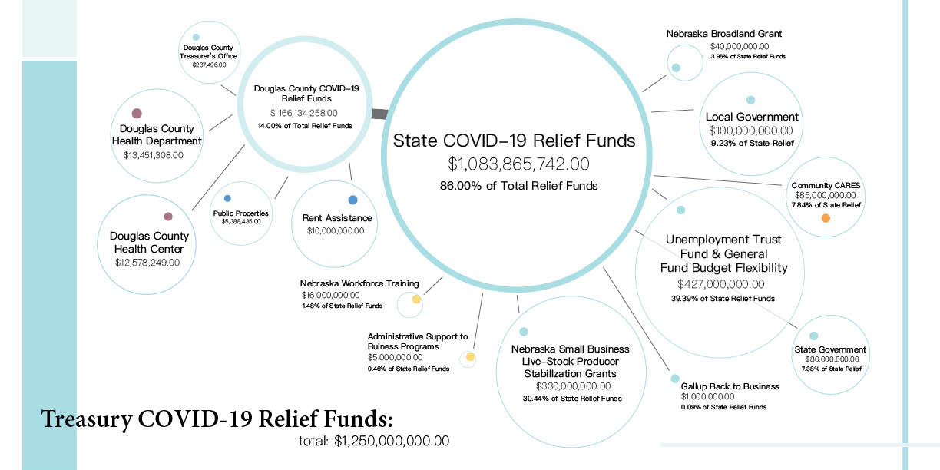

Slide 8
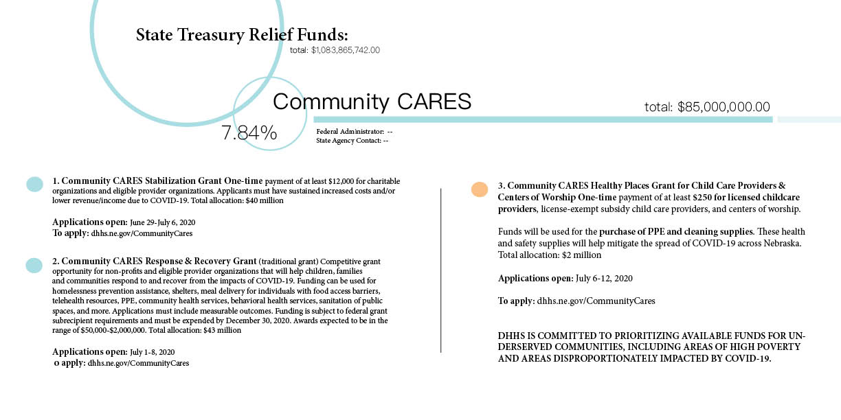

Slide 9
Community CARES R&R Basics
Funding comes from the federal Coronavirus Aid Relief and Economic Security Act (CARES Act) allocated to state governments for community-based health and human service needs created by COVID-19. ​Nebraska DHHS has three (3) separate applications currently available under the Community CARES umbrella. Response and Recovery (R&R) is one of the three.
  Organizations may apply for any or all three grant programs if they meet eligibility criteria specified by each grant program.
Applications for R&R open on July 1st and are Due July 8, 2020. ​
Award amount will range between $50,000 and $2,000,000 maximum, per entity​
Total amount allocated to the R&R grant program is $43 million​
Awards to be announced mid-July and funds to be expended by December 30, 2020.
Applications will be submitted through an online portal available here http://dhhs.ne.gov/CommunityCares
Applications are brief, with tight character limits for narrative sections between 500-3,000 characters.
Multiple applications from a community are possible. ​
Project selection criteria includes
  the applicant’s capacity to deliver needed assistance and responsibly manage federal financial assistance;
  applicant’s response to stated needs of children, families and communities in its usual service area;
  applicant’s focus on services to higher-risk population(s); and
  applicant’s budget.
DHHS is committed to prioritizing availability of funding for a) underserved communities, and b) applications with a single entity coordinating with partner organizations to streamline assistance to individuals and families in their community.

Slide 10
Eligibility Criteria

Slide 11
Eligibility Criteria
Eligible Applicants
Charitable organizations, tax-exempt under section 501(c)(3) of the Internal Revenue Code
  Can be a Collaborative if the Collaborative has its own 501c3
State of Nebraska-licensed provider of social services or health services
The applicant must currently be organized and operating in Nebraska
The applicant must serve children, families or communities in service of the DHHS mission: to help people live better lives
Ineligible to Apply for R&R Grants
• Units of local government, including tribal governments
• Hospitals
• Child Care providers
• Federally Qualified Health Centers
​
​
Notes:
License must be for thefollowing services : Adult Day Services
Assisted-Living Facilities
Centers for the Developmentally Disabled
Child Placing Agencies
Children's Day Health Services
Health Clinics
Hospice Services
Intermediate Care Facilities for Persons with Developmental Disabilities
Mental Health Substance Abuse Treatment Centers
Residential Child-Caring Agencies
Rural Health Clinics
Respite Care Services

Slide 12

  Eligible Use of Funds

Slide 13
Eligible Use of Funds
Costs are reimbursable, a one-time cash advance of up to 33% of the total award is available if needed
Expenses eligible for Response & Recovery grant funding are those which enable compliance with COVID-19 public health precautions, mitigate COVID-19 effects, or respond to the COVID-19 public health emergency.
You can supplement other funds, but not supplant them (including private donations)
One organization can apply to provide multiple service
Potential eligible expenses (not exhaustive)
  Communication and translation services for public health messaging
  Homelessness prevention assistance
  Foreclosure/eviction prevention assistance
  Meal delivery for residents with food access barriers
  Telework and telehealth resources
  PPE for staff and clients; disinfecting cleaning supplies
  Community outreach to facilitate COVID-19 response
  Sanitation of public spaces
  Improvements to public spaces to promote social distancing
Notes:
• Playbook Needs created by COVID-19

Slide 14

  Make the Case

Slide 15
Talk with your community and assess your needs
Discuss the full array of different funding streams available to meet needs and determine what gaps the R&R funding can fill – see matrix
Determine how organizations will coordinate multiple COVID-19 funding sources and increased service delivery responsibilities.
Determine how you will share accountability in the delivery of increased services through continuous communication and transparent reporting to community partners and stakeholders.

Slide 16
Use Data To Show Need and Impact
Utilize data to show your community's populations who are most severely impacted by COVID-19 health and economic consequences.
Utilize the most local and most current data available to you to help determine priority needs that your application goals and activities will address.
Vulnerability Map provides an overlay of COVID-19 and CDC's Social Vulnerability Index by county.
Nebraska Community Opportunity Map offers child, family, and community data on multiple well-being indicators and standard demographic characteristics by county.
CDC's Social Vulnerability Index Maps by County Social vulnerability refers to a community’s capacity to prepare for and respond to the stress of hazardous events. The Social Vulnerability Index (SVI 2016) County Map depicts the social vulnerability of communities, at census tract level, within a specified county. The factors include economic data as well as data regarding education, family characteristics, housing, language ability, ethnicity, and vehicle access. Overall Social Vulnerability combines all the variables to provide a comprehensive assessment.
NE Dept. of Education Data, Research, & Evaluation Home Page for the most current 2019/2020 school year data by school, district, and county. The Data Report tab includes FRM Program participation and student census by school and district level, as well as county-level student counts by grade, race, and gender.
Nebraska COVID-19 Case Summary by Race and Ethnicity Categories shows COVID cases, hospitalizations, and deaths by race and ethnicity statewide as of 05/27/2020.
COVID-19 Nebraska Cases - NDHHS COVID Dashboard by County provides county level data including: Last 14 Day Positive Cases, Total Positive Cases, Hospital Capacity, Positive Cases, Hospitalized Cases, Recoveries, and Deaths.
US Census Data
#NebraskaByTheNumbers UNO COVID-19 Data offers recent survey results UNO conducted with local governments, nonprofits, and the business sector on COVID-19 impacts they've experience thus far.
Voices for Children’s Kids Count data

Slide 17
COVID-19 Playbooks
In response to COVID-19, Nebraska Children and AVA Insights worked with
Bring Up Nebraska partners – communities, nonprofits, state, and local government – to create “playbooks” to help articulate the emergent needs of Nebraskans.
Education
Food Security
Housing
Childcare
Healthcare
Mental and Behavioral Health
Vulnerable Populations
These playbooks serve as a summary of needs and allows communities and state partners to identify gaps in services, develop plans, coordinate activities, and respond quickly to the needs of youth and families across the state.
Complete Playbooks available at:
http://www.bringupnebraska.org/tools-resources

Slide 18
HOUSING NEEDS
Housing needs, backpay of rent and other needs, have been noted as the most current priority issue by the Community Response communities.
Please be sure to reach out to the Continuums of Care and housing providers in your area to figure out who is planning to apply for the Community Cares Response and Recovery funds.
More than one organization in a community / collaborative can apply, and all applicants should describe coordination between service provider agencies and Community Response.
Up to $5 million in private funds will be made available to match the public funding that is allocated to meet housing needs.

Slide 19
HOUSING COVID-19 RELIEF FUNDS
Andrea Curtis | NHAP Program Coordinator
Children and Family Services
Nebraska Department of Health and Human Services

Slide 20
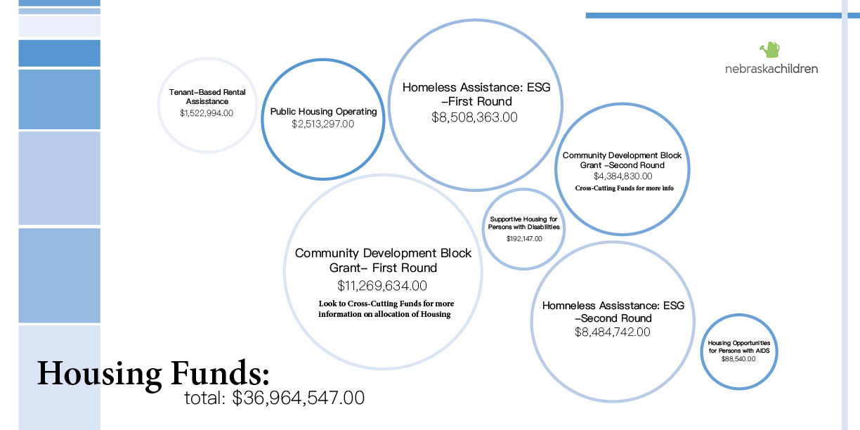

Slide 21
HOUSING RESPONSE – Private Funds
Private Funding available: Once you and/or your partners receive notice of accepted funds for individuals to meet their housing needs, please know that you can apply for private dollars from NC to help:
With upfront payments for housing assistance that will be reimbursed (once reimbursed, your agency will be able to keep the donation and continue to serve individuals with these needs)
Overhead and capacity needs (up to 10% of the award)
The amount of private funds will be made available based on expressed need and after the Community Cares Response and Recovery funds have been made available to agencies.
Please send your private funding request to Nate Smith @ nsmith@nebraskachildren.org – More details to follow (before awards will be made)

Slide 22

  Budget and Accountabilities

Slide 23
Budget FAQs
The online application provides budget preparation tools - - dropdown menus for selecting each line item category and service type, as well as a corresponding space for narrative describing the intended use of funds and the calculations used to arrive at the requested amount, as we'll see in the next two slides.
Identify additional sources of actual or expected funding related to the program proposed in this application. Federal funding must be used in addition to, not in place of, state and local funds. Important: these funds will be paid to grantees on a reimbursement basis.
For the budget narrative, use descriptions sufficient to identify each item's purpose, use, and cost reasonableness for grant reviewers to determine allowability of the cost. ​
Applicants may request indirect costs using either your federally approved indirect cost agreement rate or a 10% de minimis – see the R&R FAQ for de minimis guidance

Slide 24
Budget Narrative
Budget Line Item Narrative Description Example: Community Response Community Coordinator Request = $12,500​
The Community Coordinator will ​commit extra hours beyond their current work schedule or contract during the pandemic response to:
  Facilitate coordination and implementation of collaborative Community Response COVID-19 related work​
  Provide ongoing guidance and technical assistance on coordinated community COVID efforts, serving as a liaison to state and private COVID funding sources, and supporting efforts to secure additional funding for COVID-related needs as necessary​
  Assure support to Central Navigators and Coaches conducting outreach and providing direct case management services to young people and families seeking Community Response services as a result of the COVID pandemic's impact on their health and economic stability​
Then show the calculation used to arrive at the $12,500 amount requested:​
500 hrs between August 1, 2020 and December 30, 2020 @ $25.00/hr (contractual rate) for the CR Coordinator position = $12,500 (500 hrs x $25.00/hr = $12,500)​

Slide 25
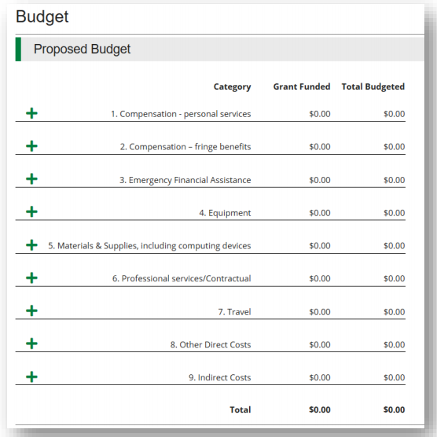

Slide 26
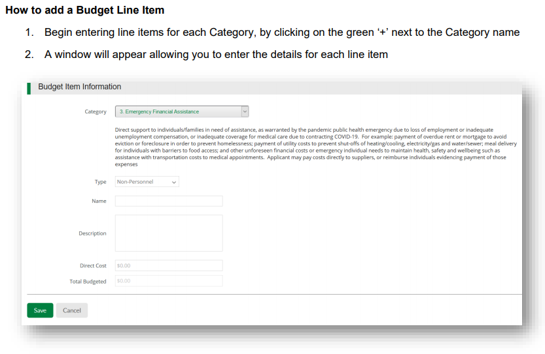

Slide 27
Reporting & Audit Requirements
DHHS expects to release the specific reporting requirements at the time of award notification. Like the application itself, reporting plans are intentionally streamlined for this funding opportunity.
Accountability is of utmost importance with this federal assistance, including but not limited to maintaining evidence of performance and applicable supporting documentation. If approved for funding, performance will be reported based on the approved plan.
R&R Grant payments are considered to be federal financial assistance subject to the Single Audit Act (31 U.S.C. §§ 7501- 7507) and the related provisions of the Uniform Guidance, 2 C.F.R. § 200.303 regarding internal controls, §§ 200.330 through 200.332 regarding subrecipient monitoring and management, and subpart F regarding audit requirements.

Slide 28

Goals

Slide 29
Performance Plan
In the Performance Plan section, you will need to outline at least three goals that you want to accomplish with this grant
Goals should be specific and measurable
Each goal will need to have:
  Name
  Activity
  Service Area
  Outcome/Result
  Completion/Due Date

Slide 30
How to Apply

Slide 31
Application Portal Tips
Watch portal instruction video – https://streamlinksoftware.wistia.com/medias/1izuuwxh15
Application FAQ - http://dhhs.ne.gov/Documents/COVID-19-Application-Guide-R%26R-Grant.pdf
Application Guide is available at - http://dhhs.ne.gov/Documents/COVID-19-FAQs-R%26R-Grant.pdf
Application is online ONLY - http://dhhs.ne.gov/Pages/COVID-19-Community-CARES-Response-and-Recovery-Grant.aspx

Slide 32
Application Portal Tips
Register with your best email address – write down your password so you can come back to the application
Contact information can be someone other than the person filling out the application
You must title your application and indicate the requested amount (between $50,000 and $2,000,000)
Save often, consider typing answers into Word or another processor and then copying and pasting into the application portal
All forms must be marked as complete

Slide 33
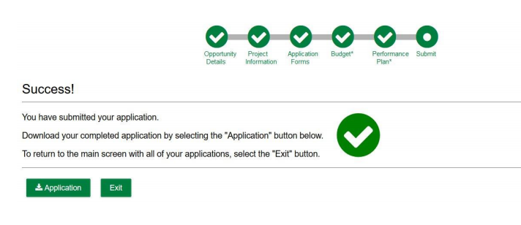
Submitting Your Application
At this point, no changes can be made to your application

Slide 34
Requirements
501(c)3 Status Letter OR Nebraska Secretary of State Registration Certificate
If a certified minority-owned organization, upload documentation of certification
Must provide
  bank account information
  EIN
  State ID number

Slide 35

  Support

Slide 36
Support for Application
Consultants
Collaborative meetings
Funding Matrix
Private Funding
Call DHHS for TA on Application
  Agency Contact Number - (833) 220-0018 (available 7am-7pm, including on Friday) or http://dhhs.ne.gov/Pages/COVID-19-Community-CARES.aspx

Slide 37
Questions?

