Slide 1
Nebraska Emergency Rental Assistance (ERA) Program
Landlord Application Process

Slide 2
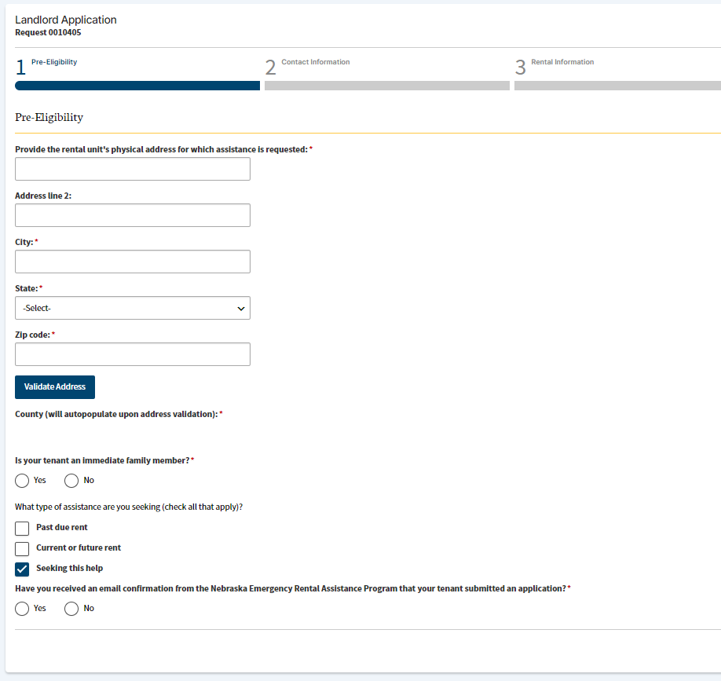
Pre-Eligibility Screen
Be sure to click the Validate Address button after entering the rental address.
If your tenant has submitted an application, be sure to select “Yes”.

Slide 3
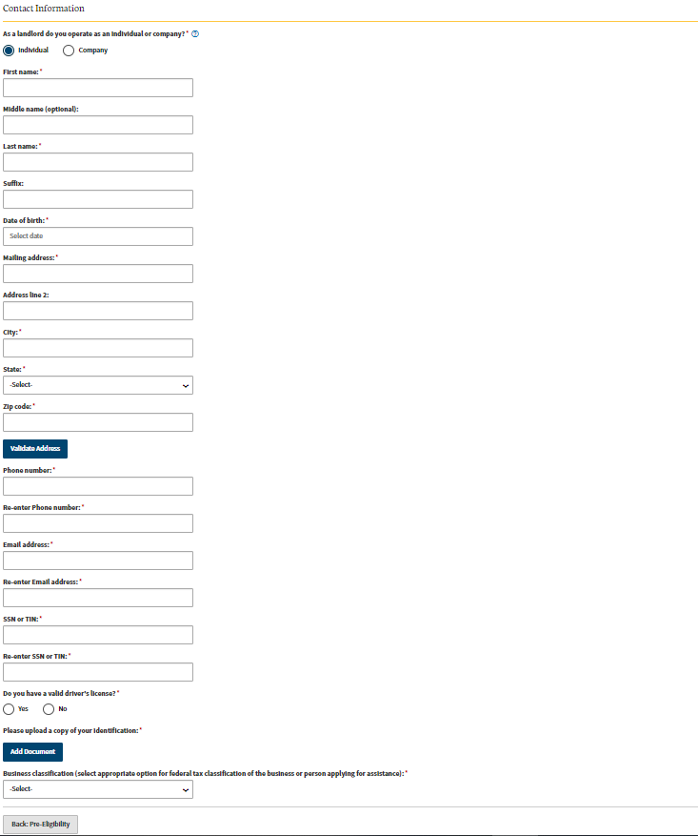
Landlord Contact Information (If Landlord is an Individual)
Select if landlord is an individual or company.
Be sure to click the Validate Address button after entering your mailing address.
Be sure to enter the correct Social Security Number or Taxpayer Identification Number
Other acceptable forms of identification include a Passport, Military ID, or U.S. Permanent Resident Card.

Slide 4
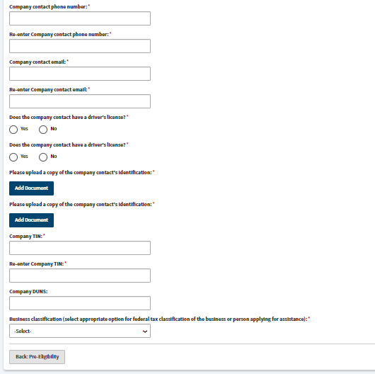
Landlord Contact Information (If Landlord is a Company)
Company contact must upload identification
Be sure to enter the correct Taxpayer Identification Number

Slide 5
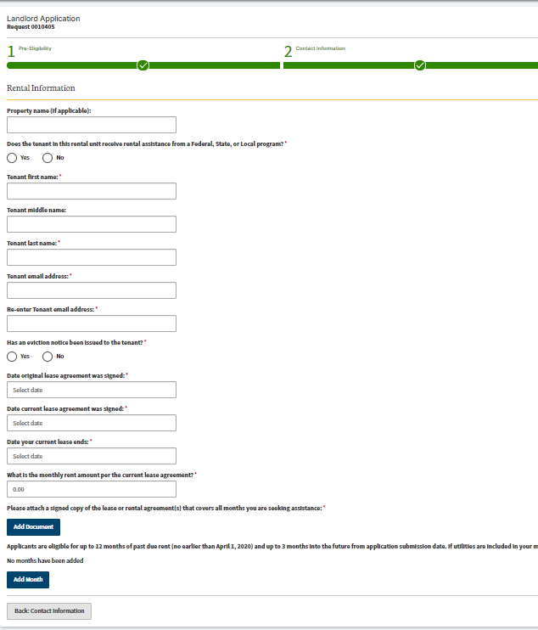
Rental Information
Tenant should be a leaseholder.
Attach a copy of the lease.
Be sure to add each month that you are requesting rental assistance for. See next page for detail.

Slide 6
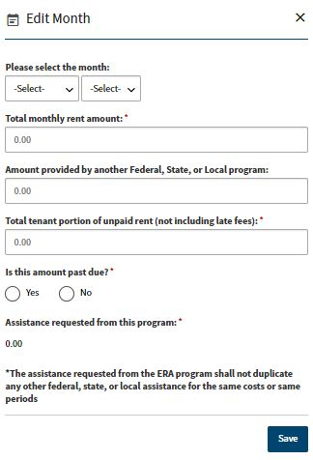
Adding Months for Rental Assistance Requested
Complete this for EACH month you are requesting rental assistance for.

Slide 7
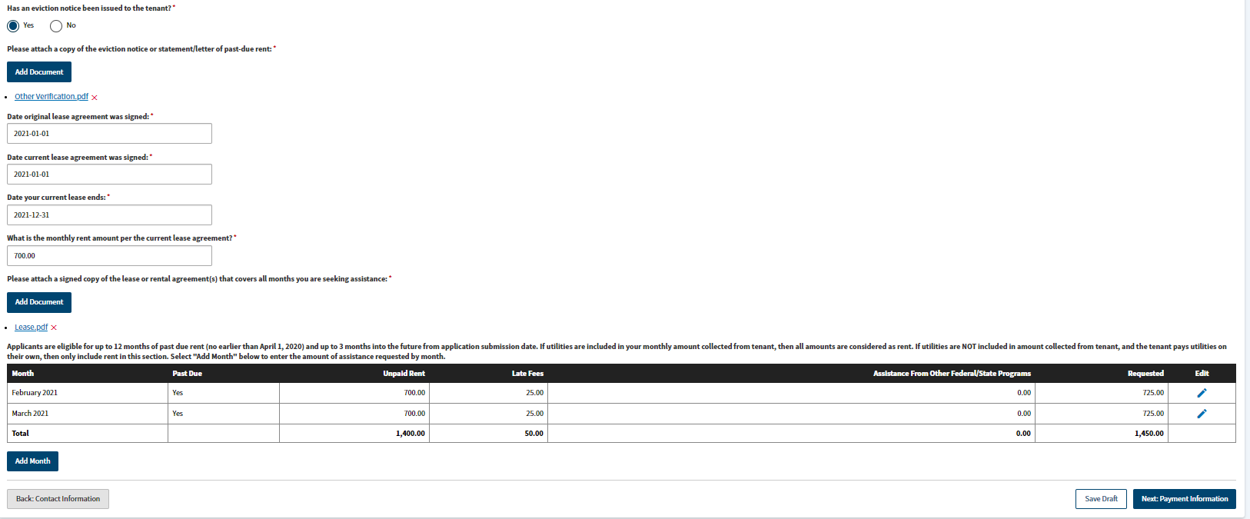
Eviction Notice Information
If “Yes” is selected for Eviction Notice, the page will look like this.

Slide 8
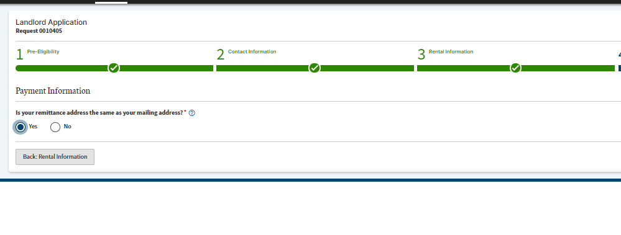
Payment Information
This is where the check will be mailed.

Slide 9
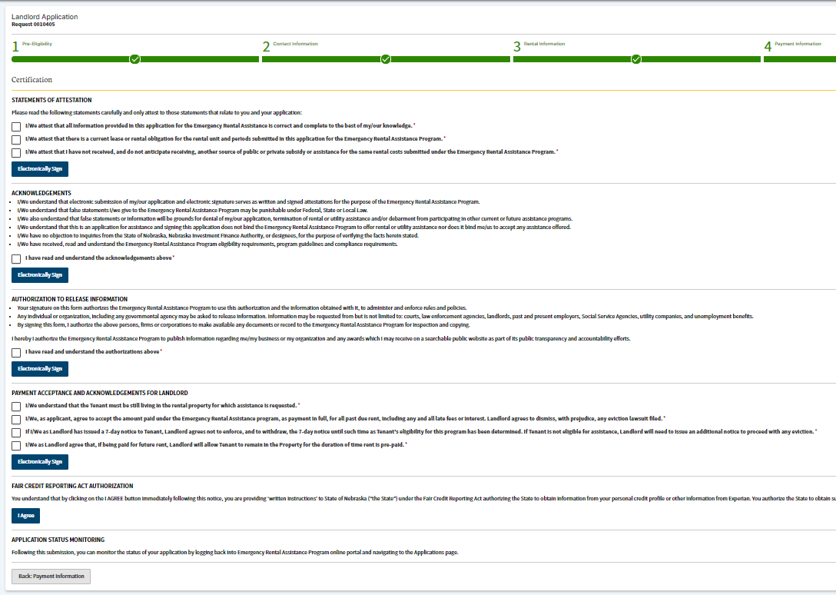
Certifications

Slide 10
For more information, please call 1-833-500-8810 or visit coronavirus.nebraska.gov

