Slide 1


Slide 2
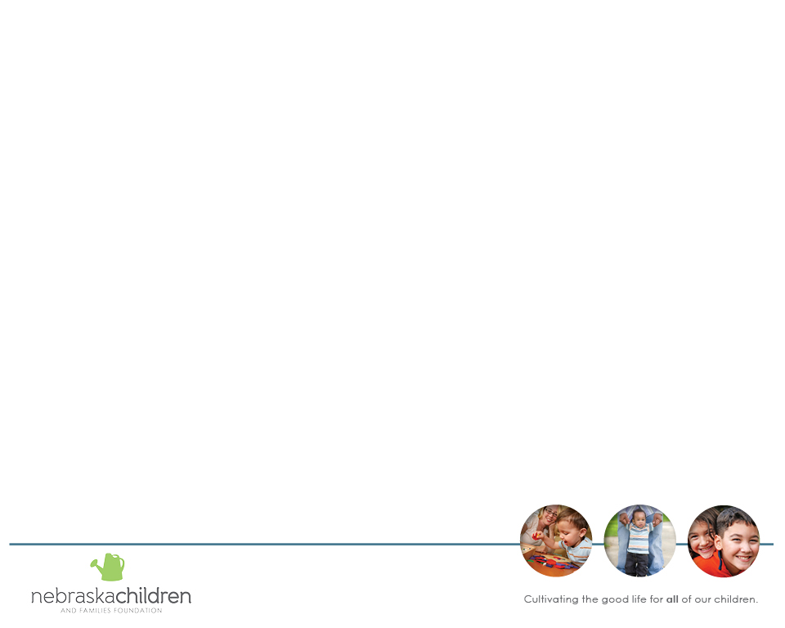
Service Array Assessment and Planning Purposes
Focus on the core resources and services in communities
to promote the enhancement of Protective Factors and
Child Well Being indicators
Identify inter-relationship of services
Identify system trends
Develop plans to address shared priorities

Slide 3
Service Array Continuum
Basic Needs
Health Care Access and Health Promotion
Child and Youth Safety and Development
Family Safety and Development

Slide 4
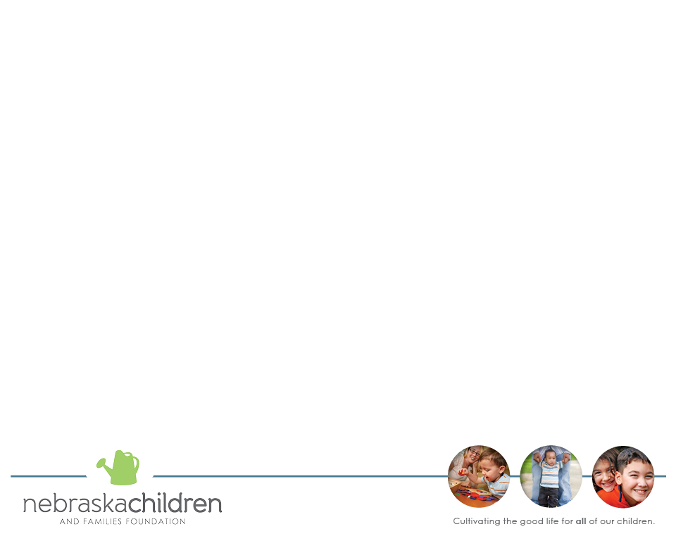
Three Main Steps
Assessment of Service Array:
Availability, Quantity, Quality, and Priority
Define Service Array Matrix:
Identifies themes and strengths
Develop Plan to Address Priorities

Slide 5
Benefit to Community Enhanced When Assessment and Planning Include:
Need: Data and experience that shows what the need is, including the reports from consumers.
Funding: Identifying funding concerns, mandates and changes that impact the delivery of the service.
Policy: Are any policy issues that affecting the delivery of the services?
Economy: How does the current economic climate affect the need for the service?

Slide 6
First Process
Service Array Assessment
Steps for Each Group with Facilitators and Recorders:
1. Review and revise definition
2. Determine Accessibility in area
3. Evaluate existing services by Quality and Quantity
4. Determine level of importance

Slide 7
Assess Availability
  Discussion Guide
  Who provides the service? List ALL agencies/providers–not just those present.
  Location. Where is the service provided?
  Have we lost (or gained) any services (providers, locations etc) in this area in the last 3 years?
  If it is available in another jurisdiction how far do people have to travel? Is transportation/gas an issue?
  Are the agencies/providers present?

Slide 8
Use Community Data
What data exists?
Quantitative: utilization, trends, wait lists
Qualitative: client surveys, community based evaluation
Consider Quantity
What about the QUANTITY of the service?
Describe the QUANTITY of the service:
(Is there enough of this service available to meet current needs?)
0 = Meets None of the Need 3 = Meets Most of the Need
1 = Meets Some of the Need 4 = Meets All of the Need
2 = Meets Half of the Need

Slide 9
Consider Quality
What is the QUALITY of this service?
Three areas to consider:
Effective: Services achieve the goals and outcomes identified in the individualized family plan; services are timely, flexible, coordinated, and accessible, delivered in the home or in the community.
Family-Centered: Services are focused on the family as a whole; service providers work with families as partners in identifying and meeting individual and family needs; family strengths are identified, enhanced, respected, and mobilized to help families solve the problems which compromise their functioning and well-being.
Culturally Responsive: Services respect the rights, values, and cultures of families; services build on the strengths of the family’s culture; services are accessible linguistically.

Slide 10
Quality Rating
Based on Effectiveness, Family Centered, and Cultural Competence:
0= Poor
1 = Occasionally Good
2 = Sometimes Good
3 = Often Good
4 = Always Good

Slide 11
Determine Level of Importance
Priority Ranking
How IMPORTANT is it to DEVELOP or CONTINUE this service?
0 = Not Important
1 = Would Be Nice
2 = Moderately Important
3 = Very Important
4 = Critically Important

Slide 12
Ranking Consideration
Importance to the overall Prevention System
Impact in reducing Intervention Services
Based on Best Practices
Small Group Breakout
Report Back

Slide 13
Second Process
Service Array Assessment Matrix
  Cross-cuts assessment to identify themes and strengths
  in the system
  Complete in small group and then combine all groups
  for larger picture
  Develop report

Slide 14
Matrix Categories
  Strong Services.
  Needed Community Education. There may be services that exist but may be underutilized because they are not well known.
  Not Meeting Enough Need. Services that exist but are not sufficiently large in scope to meet the jurisdiction’s needs.
  Advocacy and/or Service Barriers. Services could be improved if access barriers were addressed.
  Duplication of Services and Shifting of Resources. Services are provided by more than agency or organization. Consider elimination of duplications and shift resources.
  Non-Existing Services.

Slide 15
Matrix Categories continued
  Staffing/Volunteer Issues. Shortages, Training etc.
  Funding Issues. Lack of adequate funding.
  Better Coordination/Collaboration with Other Stakeholders and Providers. Services that exist could be improved if there was better service coordination and integration between providers.
  Quality Improvement Needed. services which need to be evaluated because there are questions about quality.
  More Diversified Services. Adjusted to meet more diverse needs.
  Law/Policy Change.
  Other Services Challenges.

Slide 16
Small Group Summaries
What strong services were identified?
Any significant gaps in services?
Were there areas where more information is needed- and if so, what?
Any policy issues identified?

Slide 17
Collective Impact Common Structure
for Collaboratives
Community, Parents, Children and Young Adults
Health, Informal Supports and Basic Needs
Early Childhood Workgroup
School Age Workgroup
Older Youth Workgroup
Central Navigation Community Response (Accountability, CQI, Access and Coordination)
Community Collaboration

Slide 18
Third Process
Priority Development Plan
Identify priority areas for development or enhancement in 1-3 years
Eventually should link to vision, collaborative capacity, protective factors, community context

Slide 19
What do we really want to sustain?
Outcomes-Quality Improvements
Systems and systems change
Core Services/Access
Sustaining change requires different actions and structures
from the onset.
For Systems Change
Prioritize big picture areas for development over next 3-5 years
Not necessarily programs or grants
Best Practices

Slide 20
Quick Wins
Areas that require no funding or for which the resources already exist
Changes to actions
Examples: community education, shared resources for staff training, cross training people who already have contact with a certain consumer/client group to include another function

Slide 21
Short Term
Priorities that need to be addressed within 1-3 years
Possible to accomplish but will require some resources
(time, talent, and financial)
Consider essential to Child Well Being effectiveness and outcomes

Slide 22
Longer Range
Areas which will take longer term planning or shifting of resources but which will have an impact on higher end systems of care
May require developing components of a system
(assessment, Family Centered Practice, coordination of agencies)
May require capital investment - e.g. shared information systems

Slide 23
Legal and Policy Changes
Identify legal and policy issues which are affecting the Child Well Being Prevention system
These may be areas a community can not change on its own
Shared between communities

Slide 24
Identify Impact/Complete workplan
Alignment to Child Well being Indicators
Protective Factors
Target Population
Leadership/Assigned to Collaborative workgroup
Resources
Evaluation Measures

