Slide 1
Nebraska Emergency Rental Assistance (ERA) Program
Tenant Application Information

Slide 2
Pre-Eligibility Screen
Be sure to click the Validate Address button after entering your address.

Slide 3
Application Information
Be sure to enter yourself as a household member.
Other acceptable forms of identification include a Passport, Military ID, or U.S. Permanent Resident Card.

Slide 4
Edit Household Members
If a household member does not have a social security number, enter 000000000.

Slide 5
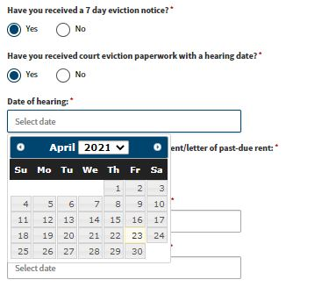
Rental Assistance Information
If you select “Yes” here, please complete the additional information requested.
Attach a copy of your lease.
Be sure to add each month that you are requesting rental assistance for. See next page for detail.

Slide 6
Adding Months for Rental Assistance Requested
Complete this for EACH month you are requesting rental assistance for.

Slide 7
Utility Assistance
Be sure to add each month that you are requesting utility assistance for. See next page for detail.

Slide 8
Adding months for Utility Assistance Requested
Complete this for EACH utility you are requesting assistance with.
Complete this for EACH month you are requesting utility assistance for.

Slide 9
Payment Information

Slide 10
Certification
You may save a draft or click “Submit” if your application is complete.

Slide 11
For more information, please call 1-833-500-8810 or visit coronavirus.nebraska.gov

