Slide 1
PDG
Communities for Kids Plus (C4K+)
Amanda Prokasky
Assistant Professor, Department of Education & Child Development
Munroe-Meyer Institute, UNMC

Slide 2
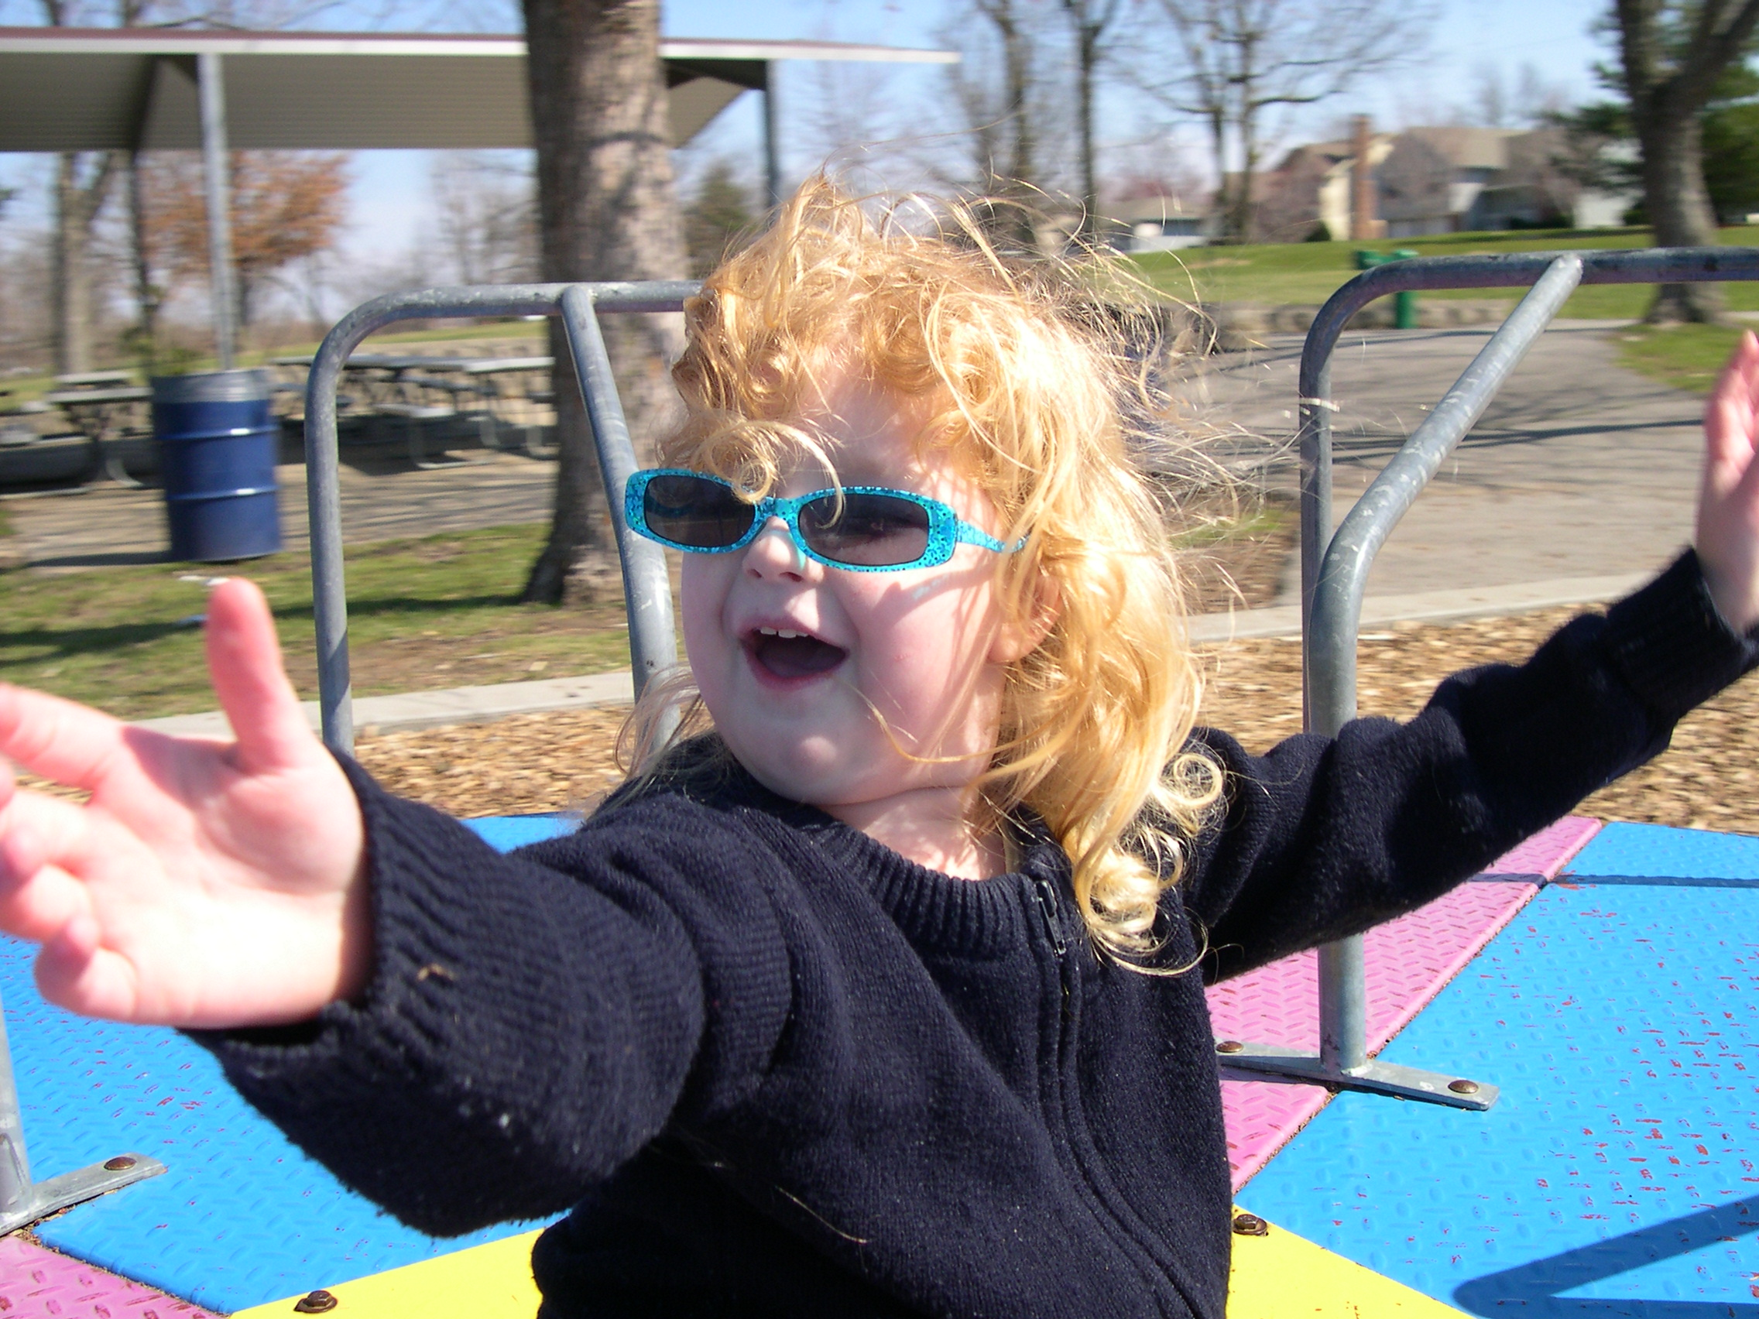
Purpose of C4K+
Build local infrastructure to focus on increasing quality, availability and families’ access to excellent early learning programs in Nebraska

Slide 3
Main Activities
Early Childhood Community Coordinators (ECCCs)
Quality and Capacity Building
Early Learning Scholarships
Bilingual Child Care Support Initiative

Slide 4

MMI Role
Design and implement Evaluation Plan
Provide evaluation support to local communities

Slide 5
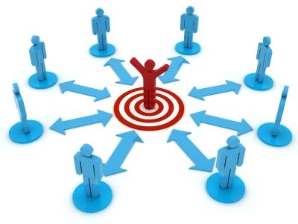
Early Childhood Community Coordinators
“Boots on the ground”
Baseline survey in December
  Training and preparation for role
  Skills needed to be successful
Notes:
Coordinate local early childhood community based efforts
Build local infrastructure

Slide 6
What we have learned about ECCCs…

Slide 7
Almost half have experience with project coordination:

Slide 8
But… aren’t new to early childhood and education!
76% have a degree in early childhood education or a related field
Half have at least FIVE years in early childhood and a third have TEN or more years

Slide 9
Top five skills ECCCs think will be most helpful in their work.

Slide 10
Interested in the ECCC position because……
Care about children and want them to have high quality care
Interested in partnering with providers to improve community
Eager to facilitate networking, connection, and partnership
Want to increase access and availability to quality early childhood care
“I love everything that this position stands for.”

Slide 11
Top Priorities:
Increasing the quality of early childhood care, services, and capacity
Connecting with providers, parents and community members to build relationships
Expanding partnerships focused on early childhood education across the community
“My goal is to educate the community on the need for high quality early childhood care and education.”

Slide 12
Some of the challenges that lie ahead:
Building support for early childhood and for change
Reaching everyone who needs to be a part of the work
Navigating COVID and getting the important work done
“Generating support for a new initiative can be extremely hard when the discussion cannot be held face to face.”

Slide 13

What’s next??
Partner Tool
Data Collection

Slide 14

Questions??

